Slide 1
Website-Based One On One Chat Application

Slide 2
Team Members
S.No | Name | Reg.No
1 | Elango L | 22500792
2 | Kondappan K | 23501134
3 | Logusubraminiyam K | 23501136
4 | Panbarasu N V | 23501143
5 | Bharath Kumar D | 23590445

Slide 3
Abstract
This project aims to develop a real-time chat application using the MERN stack and WebSocket technology. It enables users to communicate instantly with secure authentication, group chats, and multimedia sharing. The application ensures a seamless experience with a responsive UI and real-time updates.

Slide 4
Existing Problem
One-on-one chat apps face several challenges that impact security, performance, and user experience. Privacy and security remain major concerns, as not all chat apps use end-to-end encryption, leaving messages vulnerable to interception. Weak security measures can lead to data leaks, exposing sensitive user information such as phone numbers and personal details. Some apps also share user data with third parties, raising further privacy concerns. Additionally, users are at risk of phishing attacks and scams, where malicious links or fraudulent messages can result in data theft or financial loss. Another challenge is scalability and performance, as chat apps must efficiently handle high traffic and ensure real-time message delivery without delays or crashes, especially during peak usage. Poor user experience, including a cluttered interface, limited customization, and inconsistent performance across devices, can also frustrate users and decrease engagement. Addressing these challenges is essential for building a secure, efficient, and user-friendly chat application.

Slide 5
Aim Of The Project
To address the challenges faced by one-on-one chat apps, a comprehensive solution must focus on enhancing privacy and security, improving scalability and performance, and ensuring a seamless user experience. First and foremost, implementing for all messages and calls is essential to protect user data from interception and unauthorized access. Regular security audits and updates should be conducted to identify and fix vulnerabilities, while strict data privacy policies must be enforced to prevent third-party access to user information. To combat phishing and scams, advanced AI-based filters can be integrated to detect and block malicious content in real-time.

Slide 6
Technology Stack
MongoDB - NoSQL database for storing user and message data
Express.js - Backend framework for handling API requests
React.js - Frontend library for building the user interface
Node.js - Runtime environment for the server-side application
Socket.io - Enables real-time bidirectional communication between users

Slide 7
Features
User Authentication (Signup/Login with secure authentication)
Real-Time Messaging (Instant delivery using WebSockets)
Message History (Stores chat logs for future access)
Media Sharing (Supports images, videos, and files)
Group Chats (Users can create and join group conversations)
Emojis (Enhance conversations with emojis)
Offline Mode (Users can read previous messages without internet connection)
Feedback (Users can submits feedbacks )

Slide 8
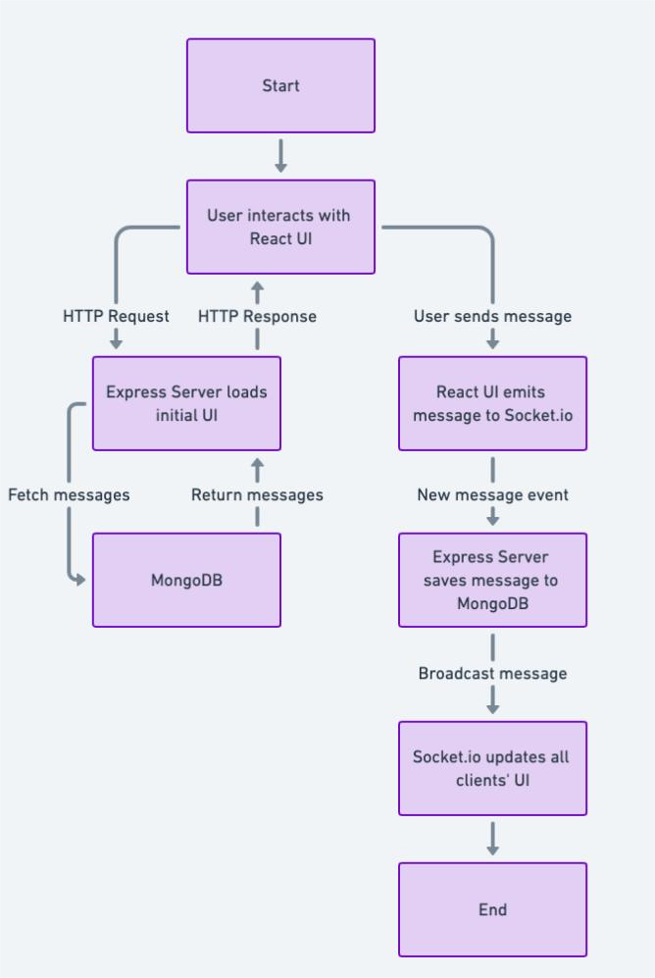
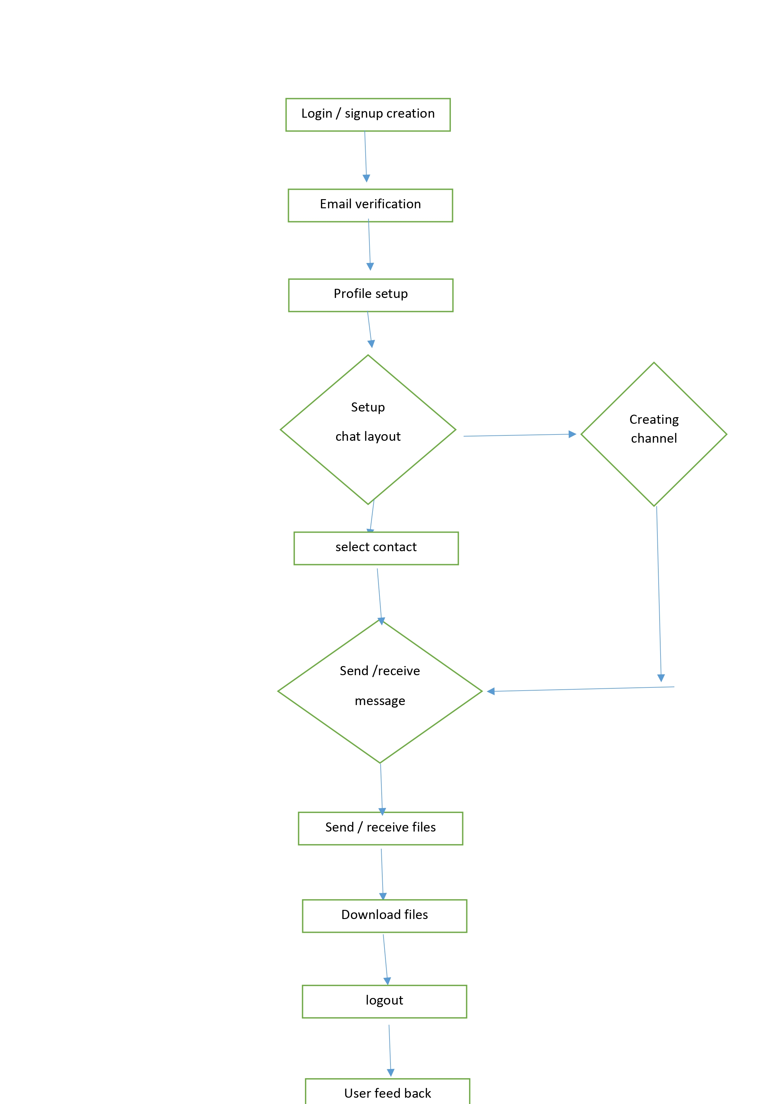
Flow Chart

Slide 9
Advantages
User Authentication – Secure login using JWT authentication and Google OAuth.
Database Integration – Uses MongoDB for storing messages and user data efficiently.
Modern Tech Stack – Built with MERN (MongoDB, Express, React, Node.js), making it scalable and maintainable.
Lightweight & Fast – Optimized performance for quick message delivery.
User-friendly Interface – Simple and easy-to-use UI.
Mobile Responsive - Its support all devices ( Desktop , Mobile , Tablet )
Group Chats - Users can create and join group conversations
Custom Feedback System – Allows users to submit feedback (with restrictions to prevent multiple submissions).

Slide 10
Disadvantages
Limited Features – Lacks advanced chat functionalities like voice/video calls, AI chat.
No Message Reactions – Lacks features like emoji reactions or message editing.
No Read Receipts – Users do not get "seen" or "delivered" message statuses.
No Message Search – Users cannot search for old messages, making it difficult to find important conversations.
No Push Notifications – Users must stay on the app to see new messages.
No Mode Switch – Does not include theme switching for better accessibility.

Slide 11
THANK YOU

